Slide 1
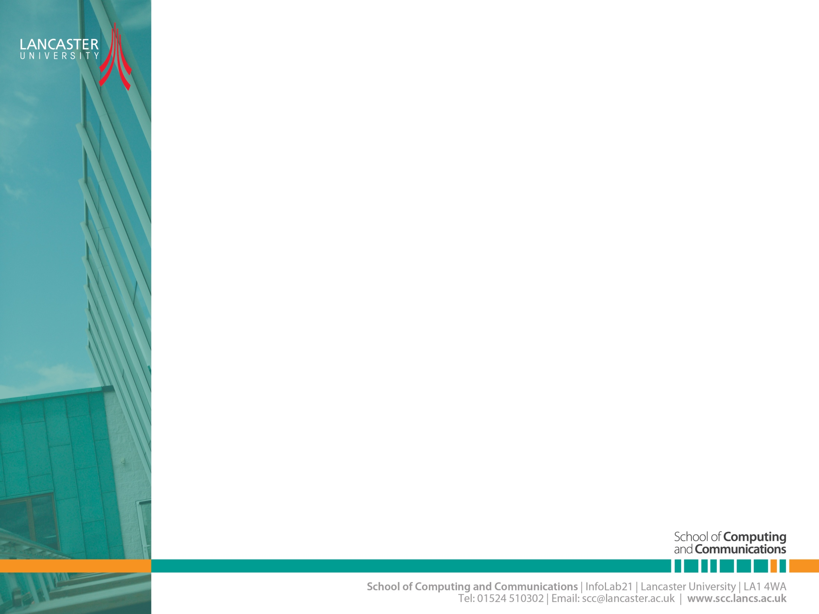

OFDM Theory and Architecture
CNSCC.405
Digital Signal Processing
Dr Muhammad Abrar (Dr. MAB)
m.abrar@lancaster.ac.uk

Slide 2


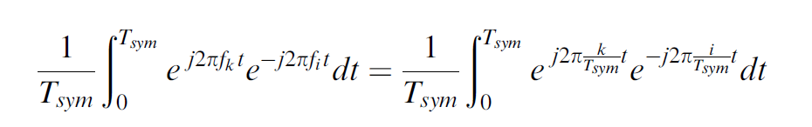
Orthogonality
Consider the complex exponential signals
Different subcarriers at
where
These signals are defined to be orthogonal if the integral of the products for their common (fundamental) period is zero, that is,
(1)

Slide 3
Orthogonality
Taking the discrete samples with the sampling instances at
(2)
The above orthogonality is an essential condition for the OFDM signal to be ICI-free.

Slide 4
OFDM Modulation and Demodulation

Slide 5

OFDM signal
OFDM transmitter maps the message bits into a sequence of PSK or QAM symbols which will be subsequently converted into N parallel streams.
Each of N symbols from serial-to-parallel (S/P) conversion is carried out by the different subcarrier.
Let denote the l_{th} OFDM signal at the kth subcarrier, which is given as

Slide 6
OFDM signal
Then the passband and baseband OFDM signals in the continuous-time domain can be expressed respectively as
and
(3)

Slide 7
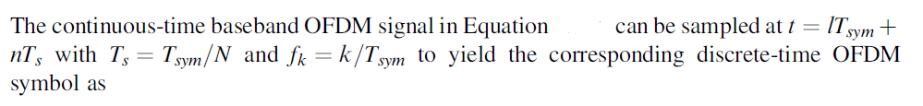

OFDM signal
(3)
(4)
Equation (4) turns out to be the N-point IDFT of PSK or QAM data symbols
and can be computed efficiently by using the IFFT (Inverse Fast Fourier Transform) algorithm.

Slide 8
OFDM signal
the orthogonality among the subcarriers in Equation (1) as follows:
(5)
where the effects of channel and noise are not taken into account

Slide 9


OFDM signal
be the sample values of the received OFDM symbol
Then, the integration in the modulation process of Equation (5) can be represented in the discrete time as follows:
(6)
Equation (6) is the N-point DFT of and can be computed efficiently by using the FFT

Slide 10
Block diagram of OFDM modulation and demodulation: N = 6

Slide 11
Block diagram of transmitter and receiver in an OFDM system.ar

Slide 12

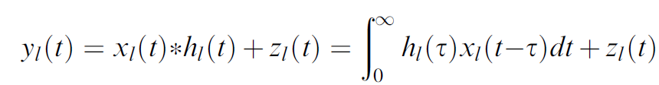

Effect of Multipath Channel on OFDM Symbols
Consider the lth OFDM signal,
For the channel with an impulse response of the received signal is given as
AWGN
(7)

Slide 13
Effect of Multipath Channel on OFDM Symbols
Taking the samples of Equation (7) at Equation (7) can be represented in a discrete time as follows:

Slide 14
Examples for the discrete-time channel
Two impulse responses with different lengths are shown along with their frequency responses.
Notes:
In order to understand an ISI effect of the multipath channel, we consider the illustrative examples for the discrete-time channel , where two impulse responses with different lengths are shown along with their frequency responses. Figure b illustrates an ISI effect of the multipath channel over two consecutive OFDM symbols. Let T_{sub} denote the duration of the effective OFDM symbol without guard interval. Since W = 1/T_{s} and thus, Df = W/N = 1=NT_{s} and T_{sub} =NT_{s} = 1=Df . By extending the symbol duration by N times (i.e., T_{sub} = NT_{s}), the effect of the multipath fading channel is greatly reduced on the OFDM symbol.

Slide 15
Effect of a multipath channel on the received signal without guard interval
ISI effect of the multipath channel over two consecutive OFDM symbols
The OFDM guard interval can be inserted in two different ways.
One is the zero padding (ZP) that pads the guard interval with zeros.
The other is the cyclic extension of the OFDM symbol (for some continuity) with CP (cyclic prefix) or CS (cyclic suffix).

Slide 16
Cyclic Prefix (CP)

Slide 17
ISI effect of a multipath channel for each subcarrier

Slide 18
ISI effect of a multipath channel on OFDM symbols
ISI effect of a multipath channel on OFDM symbols with CP length shorter than the
maximum delay of the channel.

Slide 19
ISI/ICI effect depending on the FFT window start point
ISI/ICI effect depending on the FFT window start point

Slide 20
OFDM signal-Receiver
Now we suppose that the CP length is set not shorter than the maximum delay of the channel and the FFT window start point of an OFDM symbol is determined within its CP interval (i.e., unaffected by the previous symbol). Then the OFDM receiver takes the FFT of the received samples to yield

Slide 21
Frequency-domain equivalent model of OFDM system

Slide 22
Cyclic Suffix (CS)
OFDM symbol with both CP and CS.
CS is used to prevent the interference between upstream and downstream,
used as the guard interval for frequency hopping or RF convergence, and so on.
The length of CP is set to cover the time dispersion of the channel, while the length of CS is set according to the difference between the upstream transmit time and downstream receive time.

Slide 23
Zero Padding (ZP)
Effect of a multipath channel on OFDM symbols with ZP.

Slide 24
BER of OFDM Scheme
The analytical BER expressions for M-ary QAM signaling in AWGN and Rayleigh channels are respectively given as
while Q(.) is the standard Q-function defined as
Ref: Proakis, J.G. (2008) Digital Communications 5/E, McGraw-Hill, New York.

Slide 25
Note:
if N_{used} subcarriers out of total N (FFT size) subcarriers (except N_{vc} = N - N_{nused} virtual subcarriers) are used for carrying data, the time-domain SNR, SNR_{t}, differs from the frequency-domain SNR, SNR_{f} , as follows:

Slide 26
BER performance for OFDM system with 16-QAM.

Slide 27
BER performance for OFDM system with 16-QAM.

Slide 28
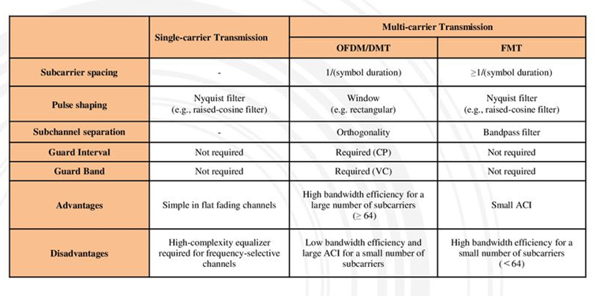
Comparison between the single-carrier and multi-carrier transmission schemes

Slide 29
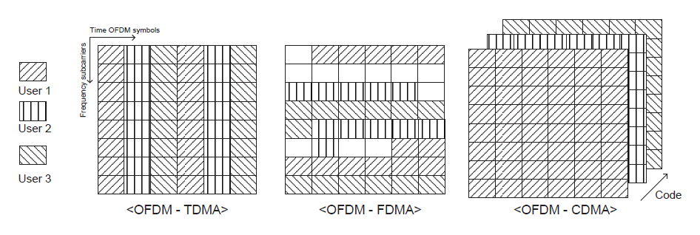
OFDMA: Multiple Access Extensions of OFDM
In general, OFDM is a transmission technique in which all subcarriers are used for transmitting the symbols of a single user.
In other words, OFDM is not a multiple access technique by itself, but it can be combined with existing multiple access techniques such as TDMA, FDMA, and CDMA for a multi-user system
Multiple access techniques used in OFDM systems

Slide 30
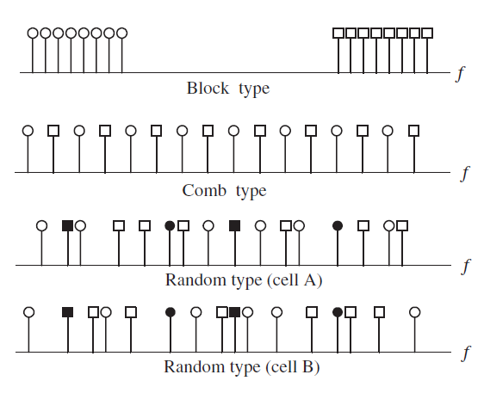
Subcarrier Allocation

Slide 31
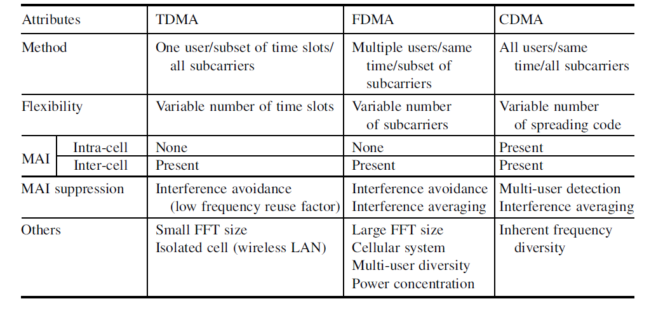
Multiple access techniques associated with OFDM: comparison

Slide 32
OFDM System Design
Carrier frequency: The frequency at which the signal is transmitted and received.
Channel bandwidth: The bandwidth of the channel over which the signal is transmitted.
Subcarrier spacing: The spacing between adjacent subcarriers in the frequency domain. This parameter affects the spectral efficiency of the OFDM system.
Guard interval: The duration of the cyclic prefix or zero padding used to mitigate inter-symbol interference (ISI) and inter-carrier interference (ICI) caused by multipath propagation.
Number of subcarriers: The total number of subcarriers used in the OFDM system. This parameter affects the granularity of the frequency-domain resource allocation.

Slide 33
OFDM System Design
6. Modulation scheme: The modulation scheme used to modulate each subcarrier. Common modulation schemes used in OFDM systems include QPSK, 16-QAM, and 64-QAM.
7. Error correction coding: The error correction coding scheme used to improve the reliability of the transmission. Common coding schemes used in OFDM systems include Reed-Solomon coding and convolutional coding.
8. Channel estimation and equalization: The methods used to estimate and equalize the channel frequency response at the receiver. Common methods include pilot symbols and training sequences.
9. Power control: The methods used to adjust the transmit power of the OFDM signal to ensure that the received signal has sufficient signal-to-noise ratio (SNR) for reliable detection.
10. Receiver sensitivity: The minimum detectable power level at the receiver. This parameter determines the maximum achievable distance of the OFDM system.

Slide 34
Example
A new broadband wireless communication system uses OFDM with 1536 subcarriers over a 30 MHz bandwidth. The system operates in an urban environment where multipath reflections are common.
a) Calculate the subcarrier spacing of the system and determine the useful OFDM symbol duration. (4 marks)
b) The system inserts a cyclic prefix (CP) equal to 1/6 of the useful symbol duration to suppress inter-symbol interference (ISI). Compute the CP duration and the total OFDM symbol duration (including CP). (4 marks)
c) The wireless channel has a maximum delay spread of 5 µs. Evaluate whether the chosen CP duration is sufficient to avoid ISI. Justify your answer with calculations. (6 marks)
d) Discuss how increasing the number of subcarriers in an OFDM system influences: (6 marks)
Resistance to frequency-selective fading
Sensitivity to carrier frequency offset (CFO) Provide a concise explanation of both effects.

Slide 35
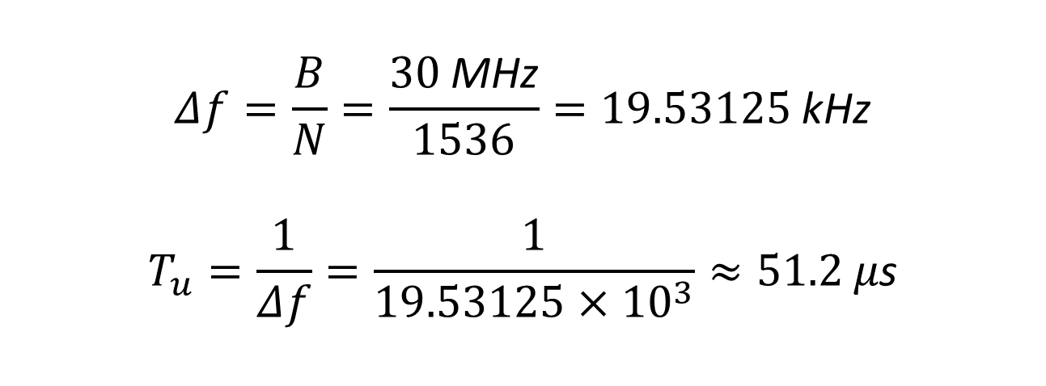
(a) Calculate the subcarrier spacing of the system and determine the useful OFDM symbol duration.
$$Δf=\frac{B}{N}=\frac{30 \text{MHz}}{1536}=19.53125 \text{kHz}$$
$$T_{u}=\frac{1}{Δf}=\frac{1}{19.53125×{10}^{3}}≈51.2 μ\text{s}$$

Slide 36
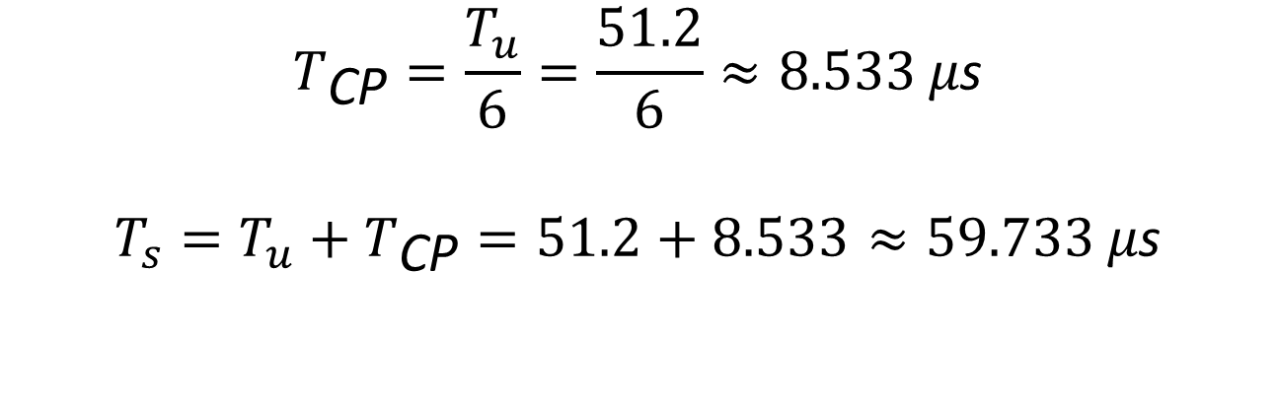
b) The system inserts a cyclic prefix (CP) equal to 1/6 of the useful symbol duration to suppress ISI. Compute the CP duration and the total OFDM symbol duration (including CP).
$$T_{\text{CP}}=\frac{T_{u}}{6}=\frac{51.2}{6}≈8.533 μ\text{s}$$
$$T_{s}=T_{u}+T_{\text{CP}}=51.2+8.533≈59.733 μ\text{s}$$

Slide 37
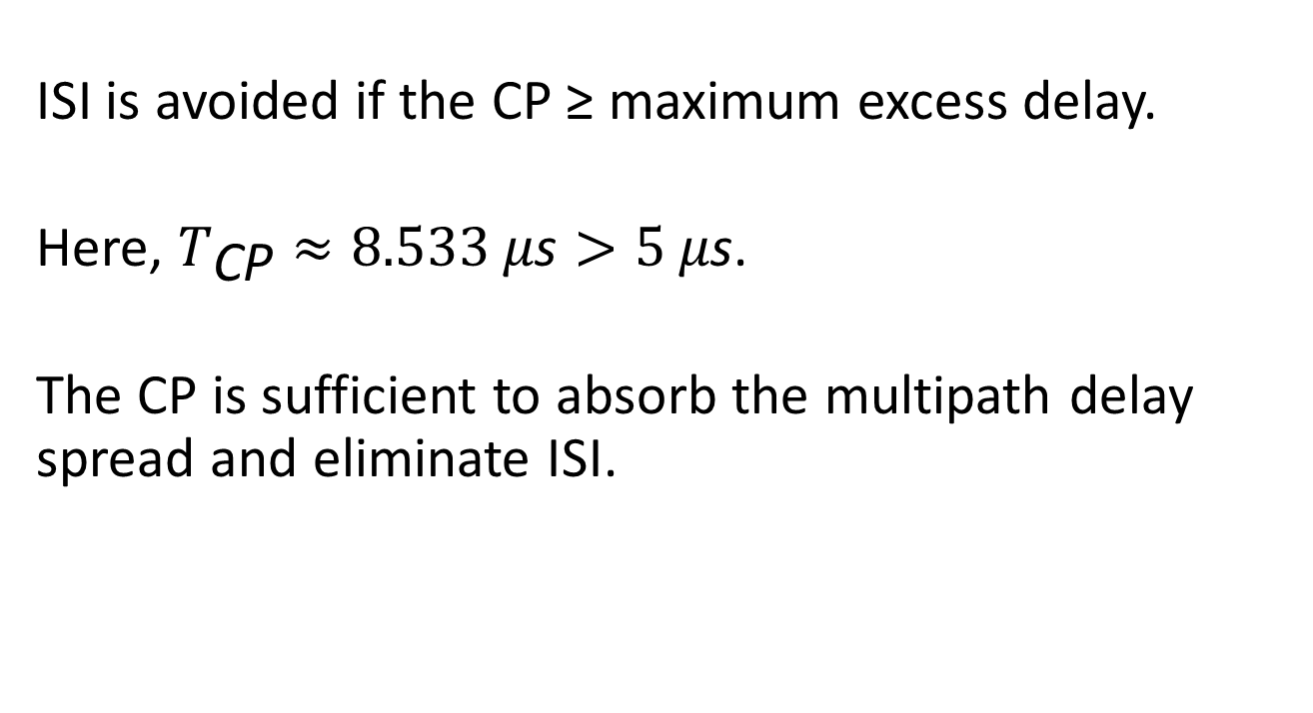
(c) The wireless channel has a maximum delay spread of 5 µs. Evaluate whether the chosen CP duration is sufficient to avoid ISI. Justify your answer with calculations.
ISI is avoided if the CP ≥ maximum excess delay.
Here, $T_{\text{CP}}≈8.533 μ\text{s}>5 μ\text{s}$.
The CP is sufficient to absorb the multipath delay spread and eliminate ISI.

Slide 38
(d) Explain how increasing the number of subcarriers in an OFDM system improves its resistance to frequency-selective fading. Your answer should clearly relate subcarrier spacing, symbol duration, and equalisation complexity.
More subcarriers → smaller subcarrier spacing.
Smaller spacing → longer OFDM symbol duration.
Longer symbols make channel delay spread small compared to symbol time.
Each subcarrier sees flat fading instead of frequency-selective fading.
Equalisation becomes simple (1-tap per subcarrier) instead of a long adaptive filter.
OFDM system becomes more robust to multipath and ISI.

Slide 39
Example
A wireless system designer is evaluating whether to switch from a single-carrier QAM system to an OFDM-based approach due to performance issues caused by ISI in a rich multipath environment.
a) Explain why ISI occurs more severely in narrowband single-carrier transmission than in OFDM-based systems.
b) In the context of multipath wireless channels, analyze how symbol duration and channel delay spread jointly determine the severity of ISI in both single-carrier and OFDM systems.
c) In an OFDM system, null subcarriers are inserted at specific locations within the spectrum. State the purpose of these null subcarriers. Explain why they are placed at the band edges and at the DC subcarrier position.
d) Describe the specific effect on OFDM symbol detection when the receiver timing is misaligned and sampling occurs beyond the cyclic prefix in a multipath fading channel. Refer to ISI and the loss of subcarrier orthogonality in your response.

Slide 40
(a) Explain why ISI occurs more severely in narrowband single-carrier transmission than in OFDM-based systems.
ISI is worse in single-carrier systems because all the data is sent in one fast stream, so each symbol is very short in time. When the signal reflects from buildings or objects, the delayed copies of the signal arrive later and overlap with the next symbol, causing interference.
In OFDM, the data is split across many slow subcarriers,
which makes each symbol much longer in time. Because the symbols are longer, the delayed reflections usually fit inside the cyclic prefix, so they do not interfere with the next symbol. That is why OFDM suffers much less from ISI compared to single-carrier transmission.

Slide 41
(b) In the context of multipath wireless channels, analyze how symbol duration and channel delay spread jointly determine the problem of ISI in both single-carrier and OFDM systems.
In wireless systems, the channel delay spread is how long delayed echoes of the signal take to arrive because of reflections.
The symbol duration is how long one bit or block of information lasts.
If the delay spread is longer than the symbol duration, then delayed echoes from the previous symbol will mix with the next one. This mixing causes Inter-Symbol Interference (ISI).
In single-carrier systems, symbols are short, so even small delay spreads can cause ISI.
In OFDM systems, symbols are made much longer by splitting data across many subcarriers. Because the symbol duration is long, echoes usually fit inside the cyclic prefix, so they don’t interfere with the next symbol.
ISI happens when delay spread > symbol duration.

Slide 42
(c) In an OFDM system, null subcarriers are inserted at specific locations within the spectrum. State the purpose of these null subcarriers and explain why they are placed at the band edges and at the DC subcarrier position.
In an OFDM system, null subcarriers are intentionally left empty to improve the quality and reliability of the transmitted signal. They serve as guard bands that prevent interference with other channels and help keep the transmission within its allowed frequency limits.
These null subcarriers are placed at the edges of the spectrum to reduce out-of-band emissions and protect neighboring frequency bands. Additionally, a null subcarrier is placed at the DC (zero-frequency) position to avoid issues caused by hardware imperfections, such as DC offset or leakage from the local oscillator. By leaving this central subcarrier unused, the system avoids distortion that could affect nearby data-carrying subcarriers..

Slide 43
(d) Describe the specific effect on OFDM symbol detection when the receiver timing is misaligned and sampling occurs beyond the cyclic prefix in a multipath fading channel. Refer to ISI and the loss of subcarrier orthogonality.
When the receiver timing is misaligned in an OFDM system and sampling starts beyond the cyclic prefix (CP), part of the delayed multipath signal from the previous symbol leaks into the useful part of the current symbol. This causes ISI because the tail end of the previous symbol overlaps with the current one.
Additionally, because the CP is no longer fully covering the channel’s delay spread, the received signal no longer represents a clean circular convolution, which is required for proper FFT processing. As a result, the orthogonality between subcarriers is lost, leading to ICI. Together, ISI and ICI distort the received symbols and make accurate symbol detection much harder, increasing the error rate.

Slide 44
Example
Suppose we want to transmit a 2 Mbps data stream over a wireless channel using OFDM with a bandwidth of 10 MHz. The channel has a frequency response that varies randomly from subcarrier to subcarrier. We want to use a 1024-point FFT for the OFDM modulation. Assume 10% of the subcarriers for pilots and a guard interval of 25% of the symbol duration.
Calculate:
No. of subcarriers
Subcarrier spacing:
Symbol duration
No. of data bits per subcarrier

Slide 45
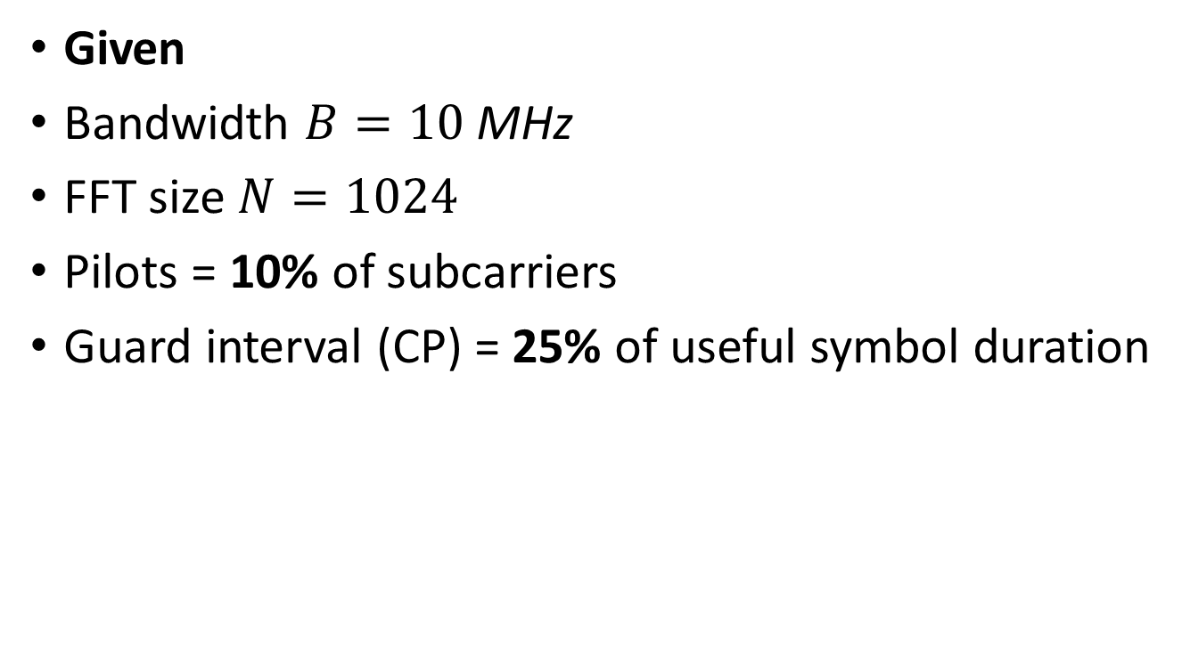
Given
Bandwidth $B=10 \text{MHz}$
FFT size $N=1024$
Pilots = 10% of subcarriers
Guard interval (CP) = 25% of useful symbol duration

Slide 46
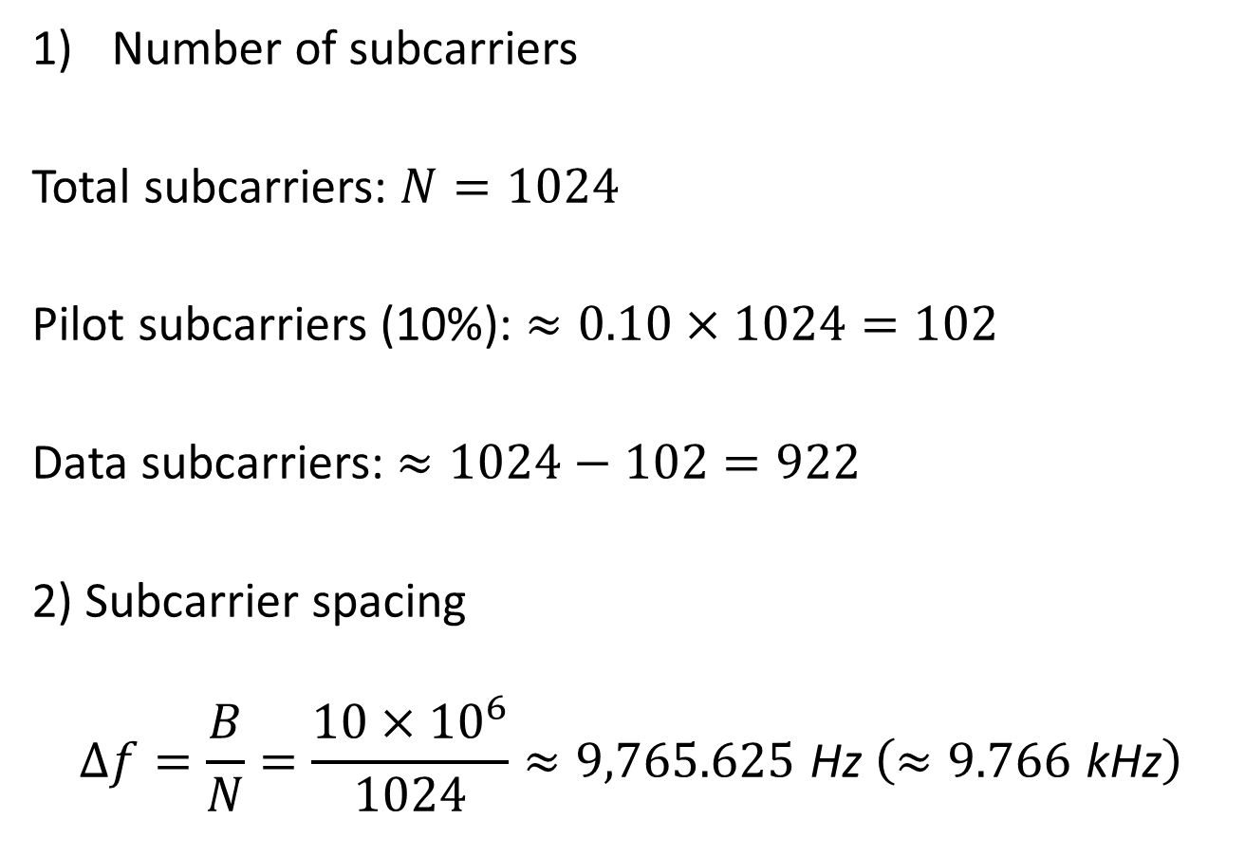
Number of subcarriers
Total subcarriers: $N=1024$
Pilot subcarriers (10%): $≈0.10×1024=102$
Data subcarriers: $≈1024−102=922$
2) Subcarrier spacing
$$Δf=\frac{B}{N}=\frac{10×{10}^{6}}{1024}≈9,765.625 \text{Hz} \left(≈9.766 \text{kHz}\right)$$

Slide 47
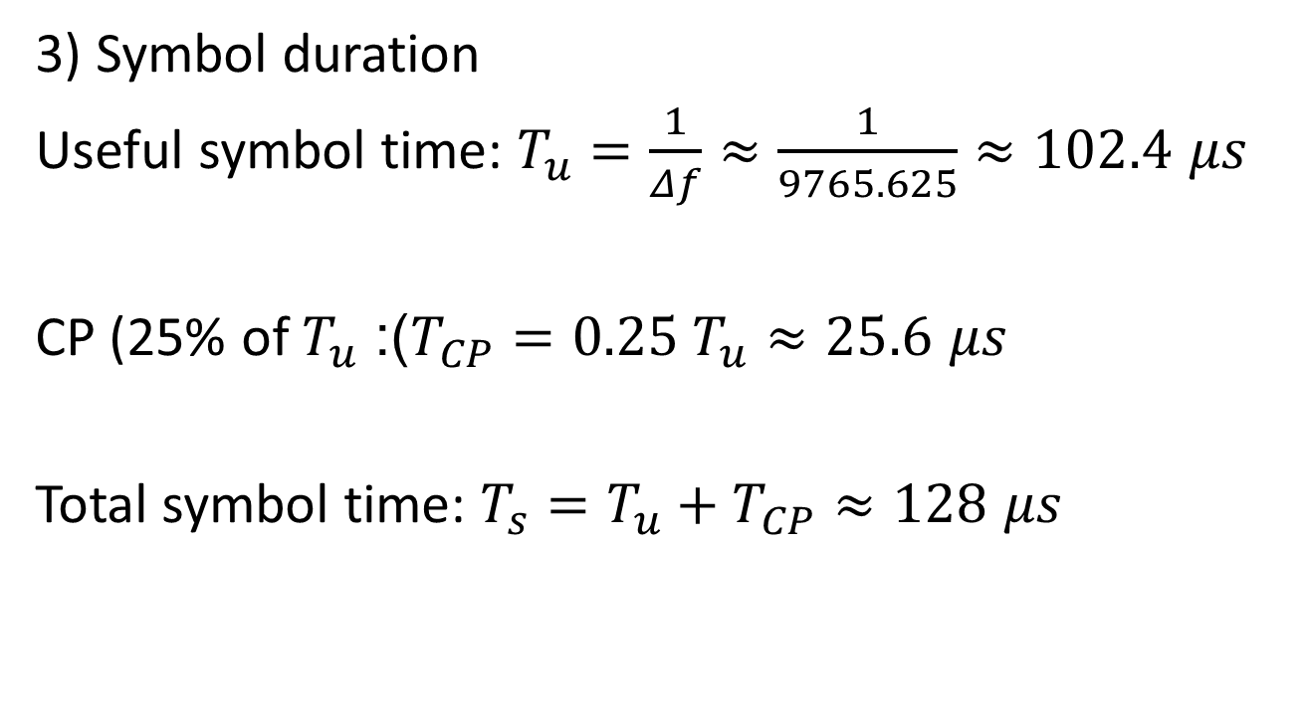
3) Symbol duration
Useful symbol time: $T_{u}=\frac{1}{Δf}≈\frac{1}{9765.625}≈102.4 μs$
CP (25% of $T_{u}$): $T_{CP}=0.25 T_{u}≈25.6 μs$
Total symbol time: $T_{s}=T_{u}+T_{CP}≈128 μs$

Slide 48
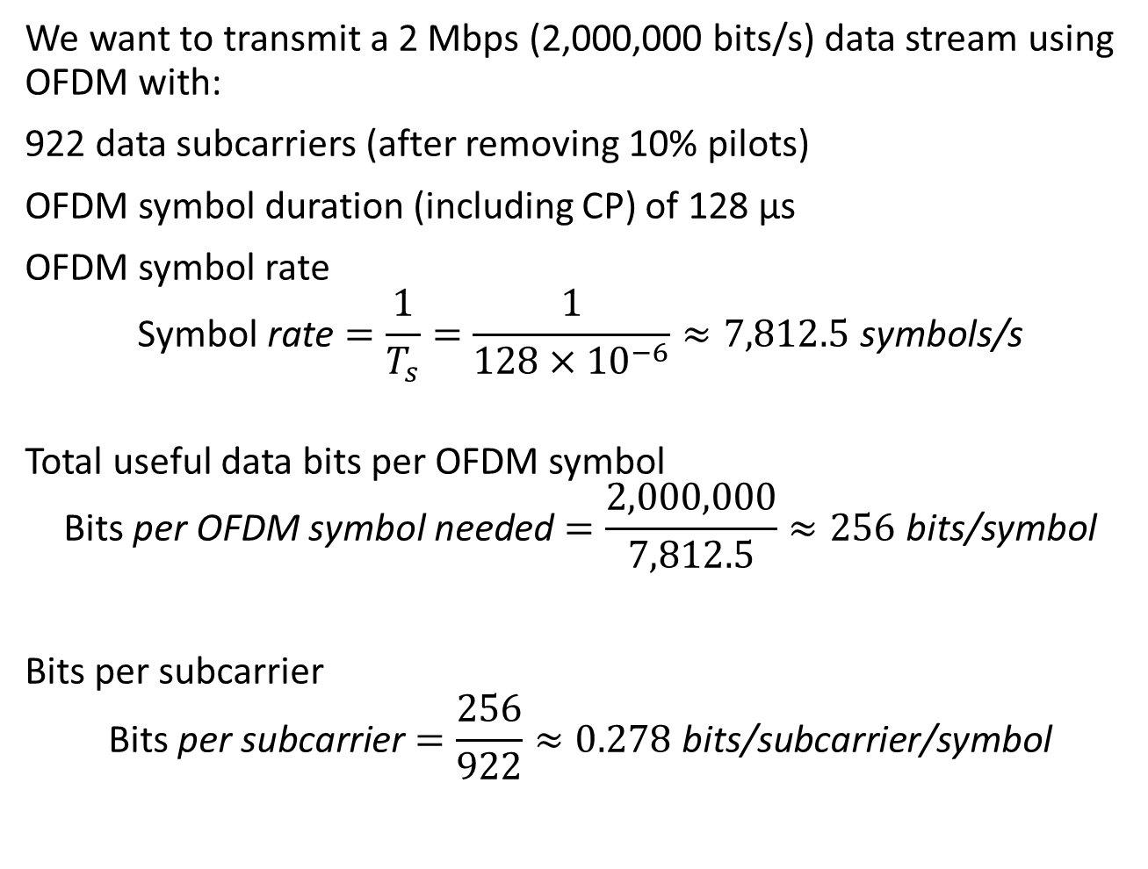
4) Number of data bits per subcarrier
We want to transmit a 2 Mbps (2,000,000 bits/s) data stream using OFDM with:
922 data subcarriers (after removing 10% pilots)
OFDM symbol duration (including CP) of 128 μs
OFDM symbol rate
$$\text{Symbol} \text{rate}=\frac{1}{T_{s}}=\frac{1}{128×{10}^{−6}}≈7,812.5 \text{symbols}\text{/}\text{s}$$
Total useful data bits per OFDM symbol
$$\text{Bits} \text{per} \text{OFDM} \text{symbol} \text{needed}=\frac{2,000,000}{7,812.5}≈256 \text{bits}\text{/}\text{symbol}$$
Bits per subcarrier
$$\text{Bits} \text{per} \text{subcarrier}=\frac{256}{922}≈0.278 \text{bits}\text{/}\text{subcarrier}\text{/}\text{symbol}$$

Slide 49
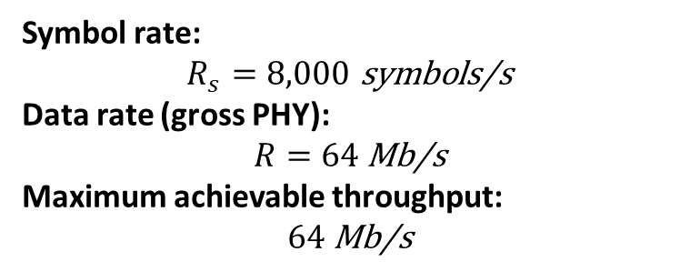
Example-Homework
Suppose a WiMAX system with the following specifications:
Carrier frequency: 2.5 GHz
Channel bandwidth: 10 MHz
OFDM modulation scheme: 256-QAM
Subcarrier spacing: 10 kHz
Cyclic prefix ratio: 1/4
Calculate the symbol rate, data rate, and maximum achievable throughput of the system.
Symbol rate: $$R_{s}=8,000 \text{symbols}\text{/}\text{s}$$
Data rate (gross PHY): $$R=64 \text{Mb}\text{/}\text{s}$$
Maximum achievable throughput: $$64 \text{Mb}\text{/}\text{s}$$

